Slide 1



ELECTION DATA ANALYSIS
03

Slide 2


TOPIC OUTLINE
INTRODUCTION
DASHBOARD CREATION
INSIGHTS
RECOMMENDATION
02

Slide 3


INTRODUCTION
Welcome to the 2024 Election presentation.
In this presentation we will get to know about the result of 2024 general election, competing parties, number of seats won in different constituencies of different states and we will get to know about the insights and recommendation for upcoming elections.
04

Slide 4
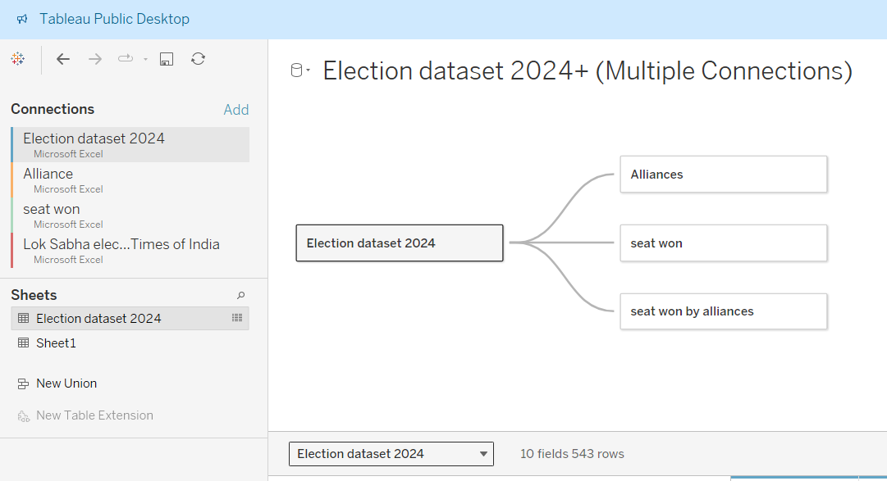
DASHBOARD CREATION
We start by connecting multiple tables and making a single table.
05

Slide 5
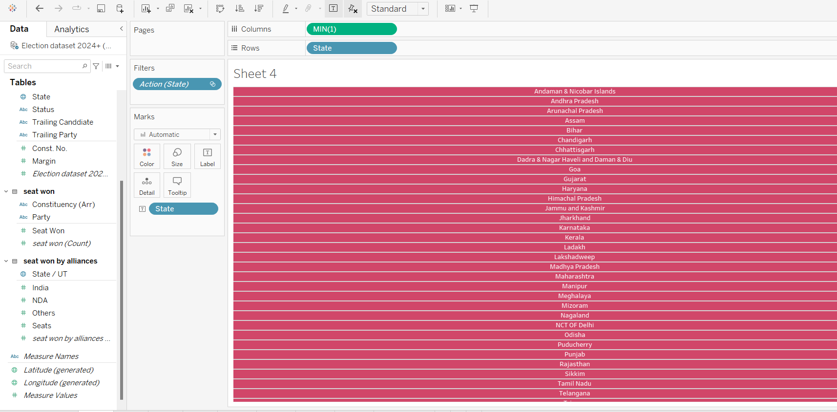

we start by creating buttons through which we can apply filter to the chart.
06

Slide 6
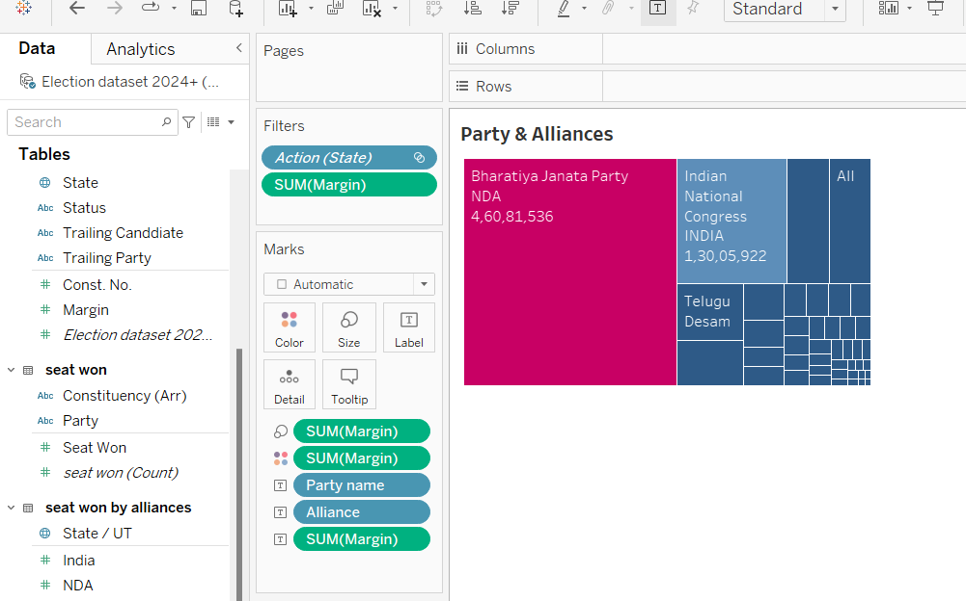

Then we will create party alliance chart with tree map chart to get to know which party has made a alliance to win the election.
07

Slide 7
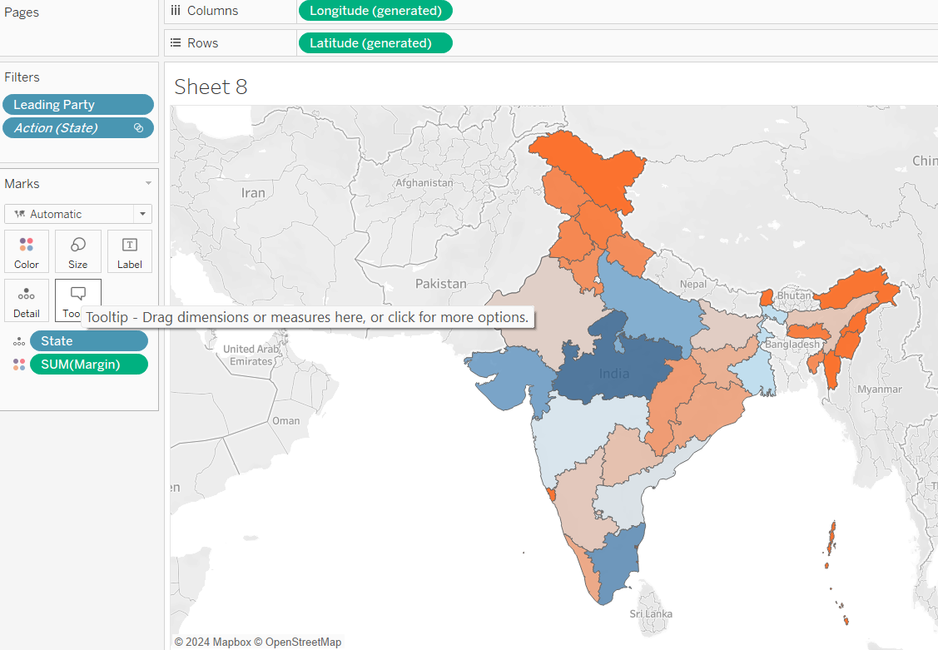

VOTER RIGHTS
We will create area map chart which will indicate different color for highest and lowest margin to check in which area there is high competitiveness.
08

Slide 8
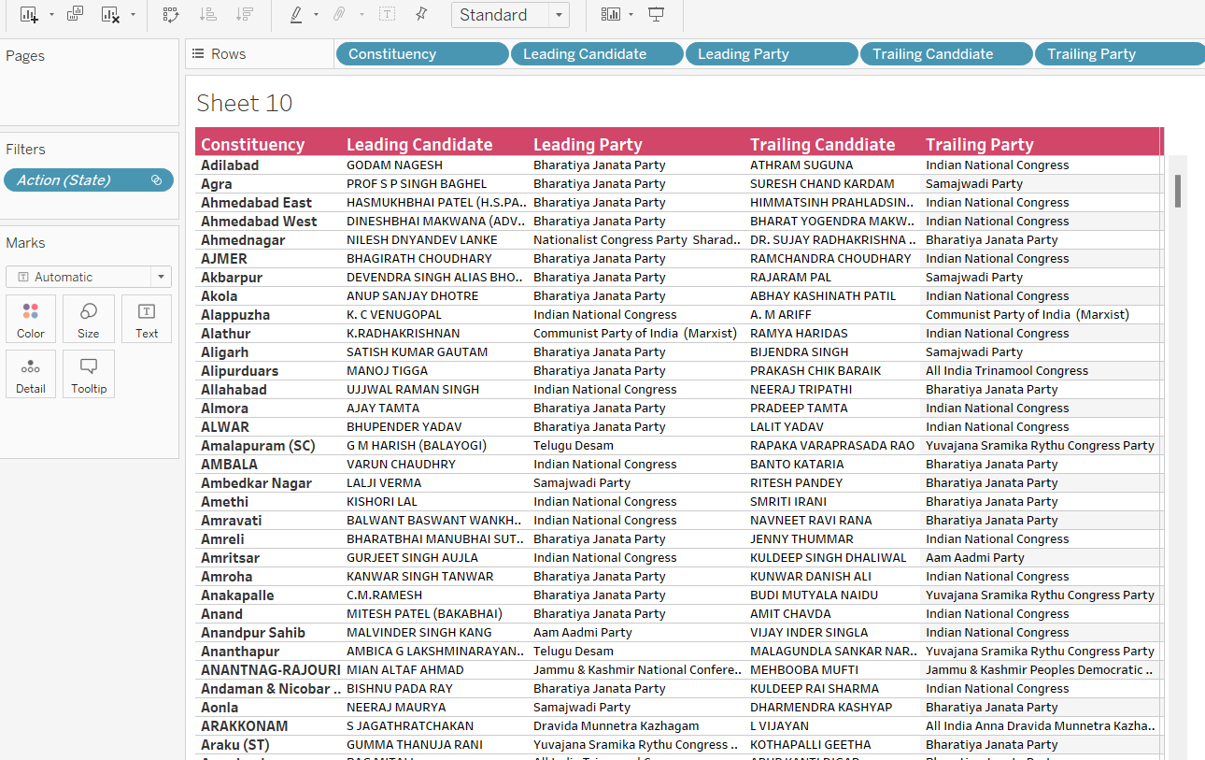
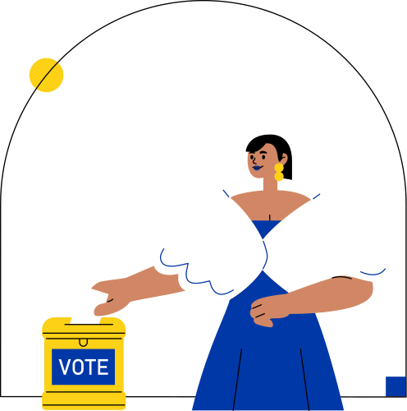
Next we will create a list of different candidate leading and trailing in different constituencies which will give a descriptive idea of winning party
09

Slide 9
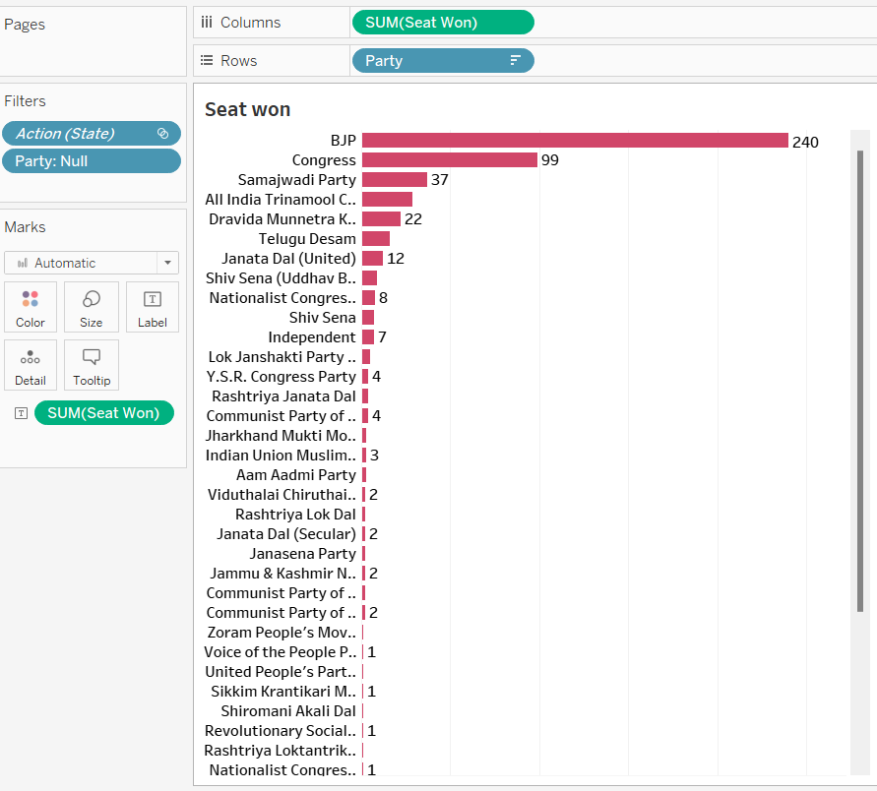

RESOURCE PAGE
Next we will create a bar chart for number of seats won by different parties
Use these design resources in your Canva Presentation. Happy designing!
Delete or hide this page before presenting.
10

Slide 10
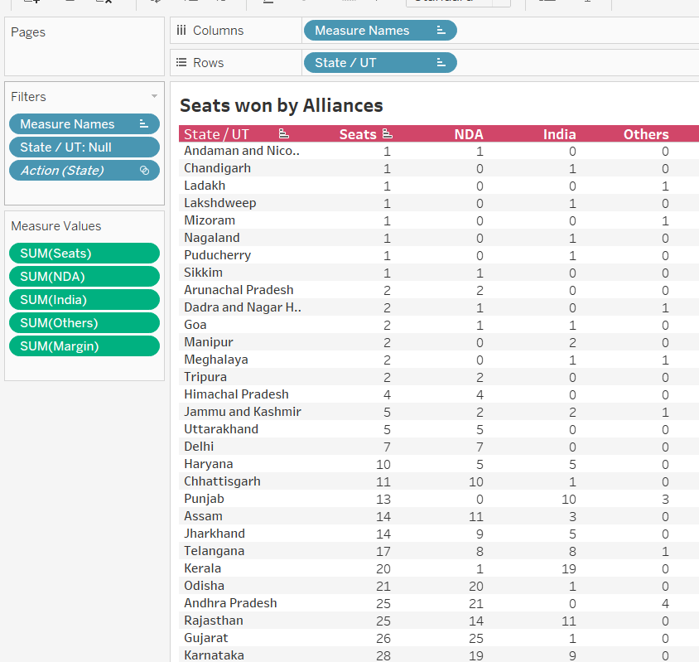
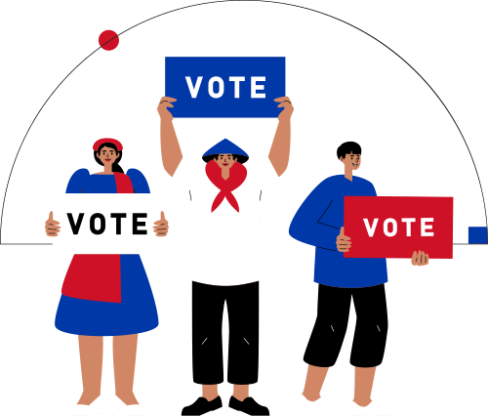
we will create a chart to get the total number of seats and total seats won by different alliances in different constituencies
11

Slide 11
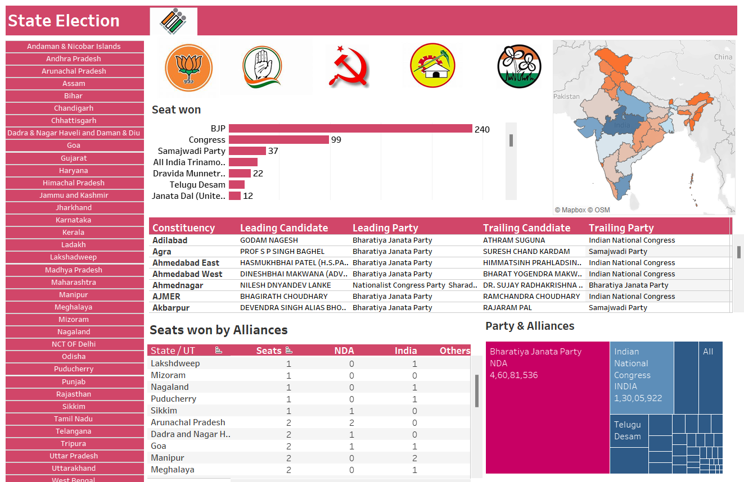


We will create a complete dashboard with all the sheets created with containers adjusted accordingly, giving a suitable title and insert pictures which will be visually appealing as well as informative
12

Slide 12
Insights
In most of the constituencies we ca see that BJP candidates have won winning about 240 over all however as compare to previous election where they had won about more than 300 seats we see there is a significant decline in the number of seats won.
Congress won 99 seats which was the second largest in the election held.
Rest number of seats were won by other parties like Samajwadi part, TMC, Telegu Desam, DMK, etc.
However there was dominance of BJP in most of the constituencies, the alliances created by the political parties worked out for most parties and secured them with seats
High level of competition can be seen through out the constituencies however in many states there was a dominance of a single majority party
13

Slide 13

Recommendation
Election plays a significant role in the development of the county, people must be sincere about whom to vote and choose there leaders carefully.
Judiciary should be cautious for misconduct and mishaps during the election and ensure fair election through out the country.
Parties should ensure proper development after getting elected and mostly focus on areas where they have lost with high majority or won by simple majority.
Judiciary must ensure that every individual can vote without getting deprived by their rights.

